Slide 1
Final Evaluation Report Chat app v1.0
The Open University of Sri Lanka
Mobile Application Development for Android | EEI 4369
W.M.D.H.Gunarathna (Reg:421643720)
G10 (M.P.C.Sandaru)

Slide 2
Table of Contents
Project Overview
Introduction
Objectives
Methodology
System Design
Features and Functionality
Implementation
Testing and Evaluation
User Interface and User Experience
Conclusion
References
Appendix

Slide 3
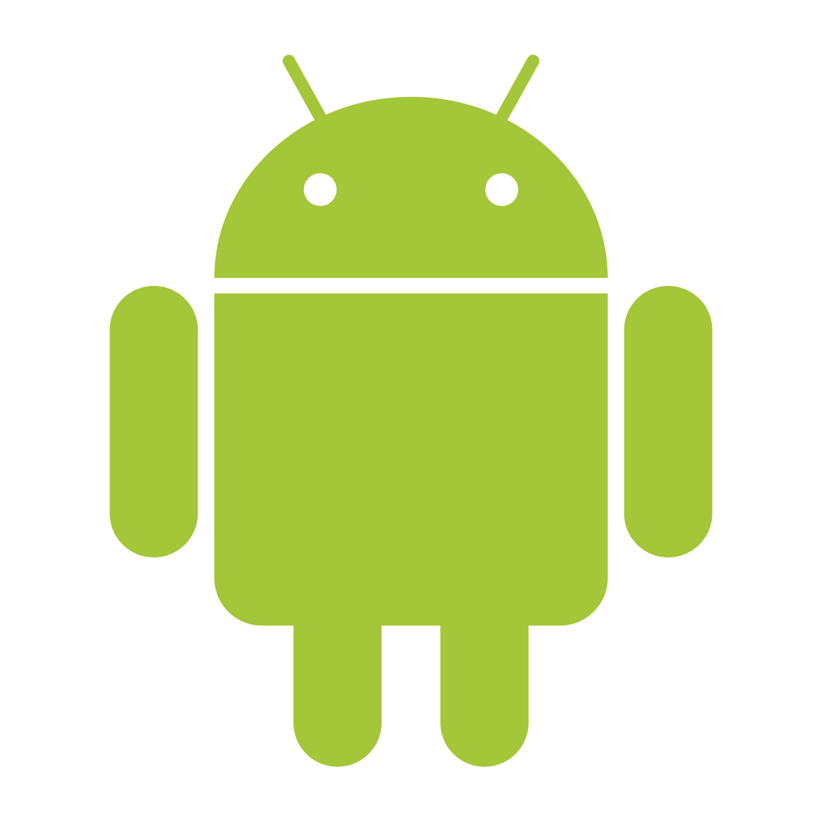
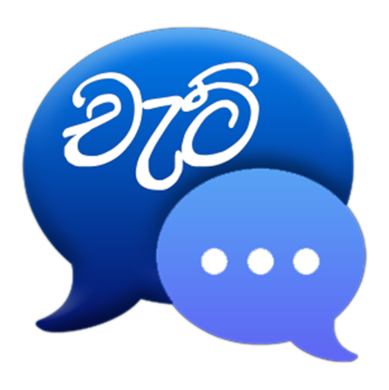
Project Overview
Chatting is a method of using technology to bring people and ideas despite of the geographical barriers. This Project is an example of a real time chat application. It is made up of two application the client app ,which runs between any two users only..
Chat app
Version 1.0

Slide 4
Introduction
Collaboration and communication are the foundation of building a successful work environment and culture. There are an array of ways for team members to communicate, and today's modern professional doesn't want to be inundated with emails.

Slide 5
Objectives
Real-time messaging features within apps have made conversations in a virtual environment more interactive and engaging.
Above this, several other features like typing indicators, message history and push notifications etc. users everything they need to communicate with others directly on your app, limiting the need to opt for other external platforms.
In-app Chat is an instantaneous form of communication. In fact, text messaging has become the primary interaction channel for millennials across the globe. When you develop chat within an app, you get to connect from 2 users with each other to a number of users within the same space.
A real-time chat application offers users a quick and proactive space to interact with each other. In other words, the user engagement is very high in a live messaging app as the response rate is quicker than the traditional modes of communication.

Slide 6
Methodology
Development tools | Programming languages | Frameworks and libraries | A P I s
Android Studio Electric Eel | 2022.1.1 | Java | multidex:2.0.1 firebase-bom:31.2.2 retrofit:2.9.0 firebase-firestore:24.6.1 junit:4.13.2 Gradle Plugin 7.2.2 Android SDK | Crashlytics API Push Notification API
Android Studio is the official integrated development environment for Google's Android operating system, built on JetBrains' IntelliJ IDEA software and designed specifically for Android development. | JAVA is a programming language which is used in Android App Development. It is class based and object oriented programming whose syntax is influenced by C++. | App development for Android has become easier with new libraries and frameworks being released almost every day of the year. | API is the acronym for application programming interface — a software intermediary that allows two applications to talk to each other. APIs are an accessible way to extract and share data within and across organizations.

Slide 7
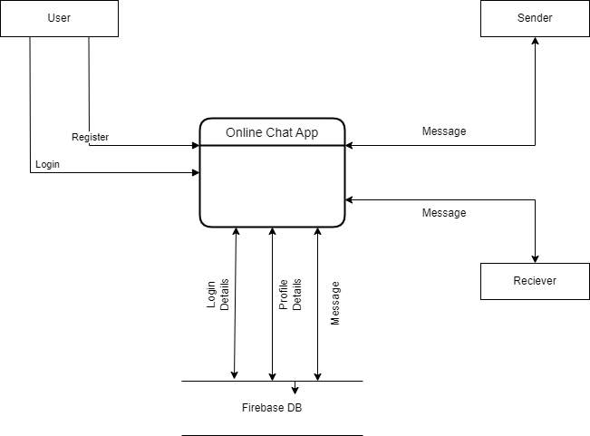
System Design
Version 1.0

Slide 8
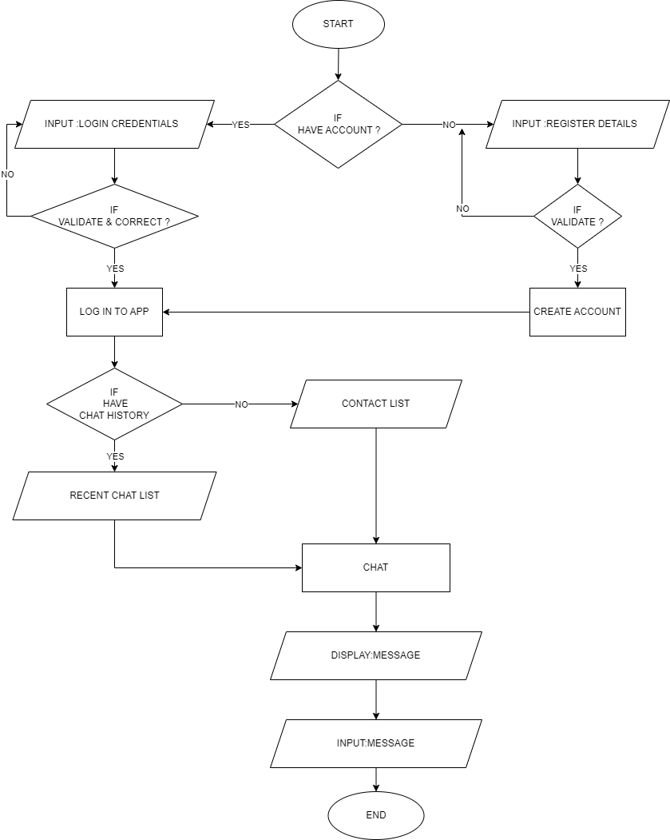

Slide 9
Features and Functionality
Registration & Login | Obviously, users must first register to use the software. Not-so-obviously, this very first encounter is your chance to provide a seamless onboarding experience. Bear in mind that without it, users may abandon the tool altogether.
Push notifications | Chat app users must be notified when a new message arrives while they aren’t currently using the app. As with most apps, enable users to customize their notifications – they may want to know when a recipient has read their message or when a specific contact is online. We may also find it useful for direct communication with app users
Contacts | People typically use chat apps to stay in touch with their friends – in these cases, the more contacts they have in the app, the more often they will be using it. The same applies to messaging apps used for work purposes. For that reason, it’s important to make integrating contacts as convenient as possible – they should be imported from the contacts book automatically. It should also enable users to browse available users through their email addresses.
User statuses | Users need to be able to see the messages they receive immediately, or as soon as they go online. With that, users would also like to know who is currently online, or when was the last time they were present online. this chat app will also indicate when a person on the other end is online and display message statuses.
Conversation history | Users expect to have their conversation history stored on their devices with the ability to easily browse through chat history in search for links, files or details from the message exchanges with their friends, family or coworkers.

Slide 10
Implementation
Hardware | Software | User permission
Octa-core (2x1.6 GHz Processer 32GB Internal storage 4GB RAM 5”inch LCD Display 8MP Camera Accelerometer 4G Network or WIFI | Android 7.1.2 (Nougat) Google Play services | android.permission.CAMERA android.permission.WRITE_EXTERNAL_STORAGE android.permission.INTERNET

Slide 11
Testing and Evaluation
ID | Test Case | Description | Steps | Expected Result
1 | Sending a Message | Verify that a user can successfully send a text message to another user. | Open the chat interface. Compose a new message. Enter the recipient's name or contact information. Type the message content. Click on the send button. | The message is sent and displayed in the recipient's chat interface
2 | Receiving a Message | Confirm that a user can receive a text message from another user. | Open the chat interface. Wait for a new incoming message. | The received message is displayed in the chat interface with the correct content and sender information.
3 | Push Notification | If Receiver offline or not use in the app now, then send push notification to inform new message | Send a message from one user to another. Check receiver now offline Wait for a incoming Notification. | The received notification is displayed in the receiver’s Notification panel
4 | User Profile Display | Ensure that user profiles are displayed correctly. | Open the user profile page. Verify that the user's name, profile picture, and other relevant information are displayed accurately. | The user's profile information is correctly presented in the app.
5 | Error Handling | Validate that error messages are displayed appropriately when encountering issues. | Simulate a network disconnection. Attempt to send a message. | An error message is displayed indicating the failure to send the message due to a network issue.
6 | Performance and Responsiveness | Evaluate the app's performance and responsiveness under different scenarios. | Simulate a high volume of messages being sent and received simultaneously. Measure the app's response time and overall performance. | The app should handle the load efficiently without significant delays or crashes.

Slide 12
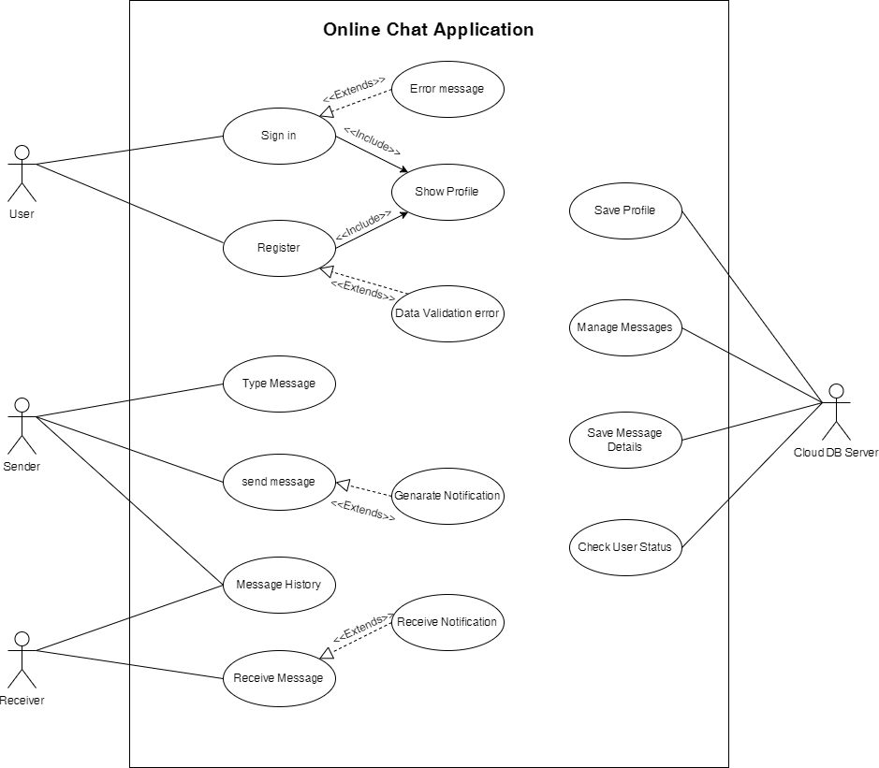
User Interface and User Experience

Slide 13
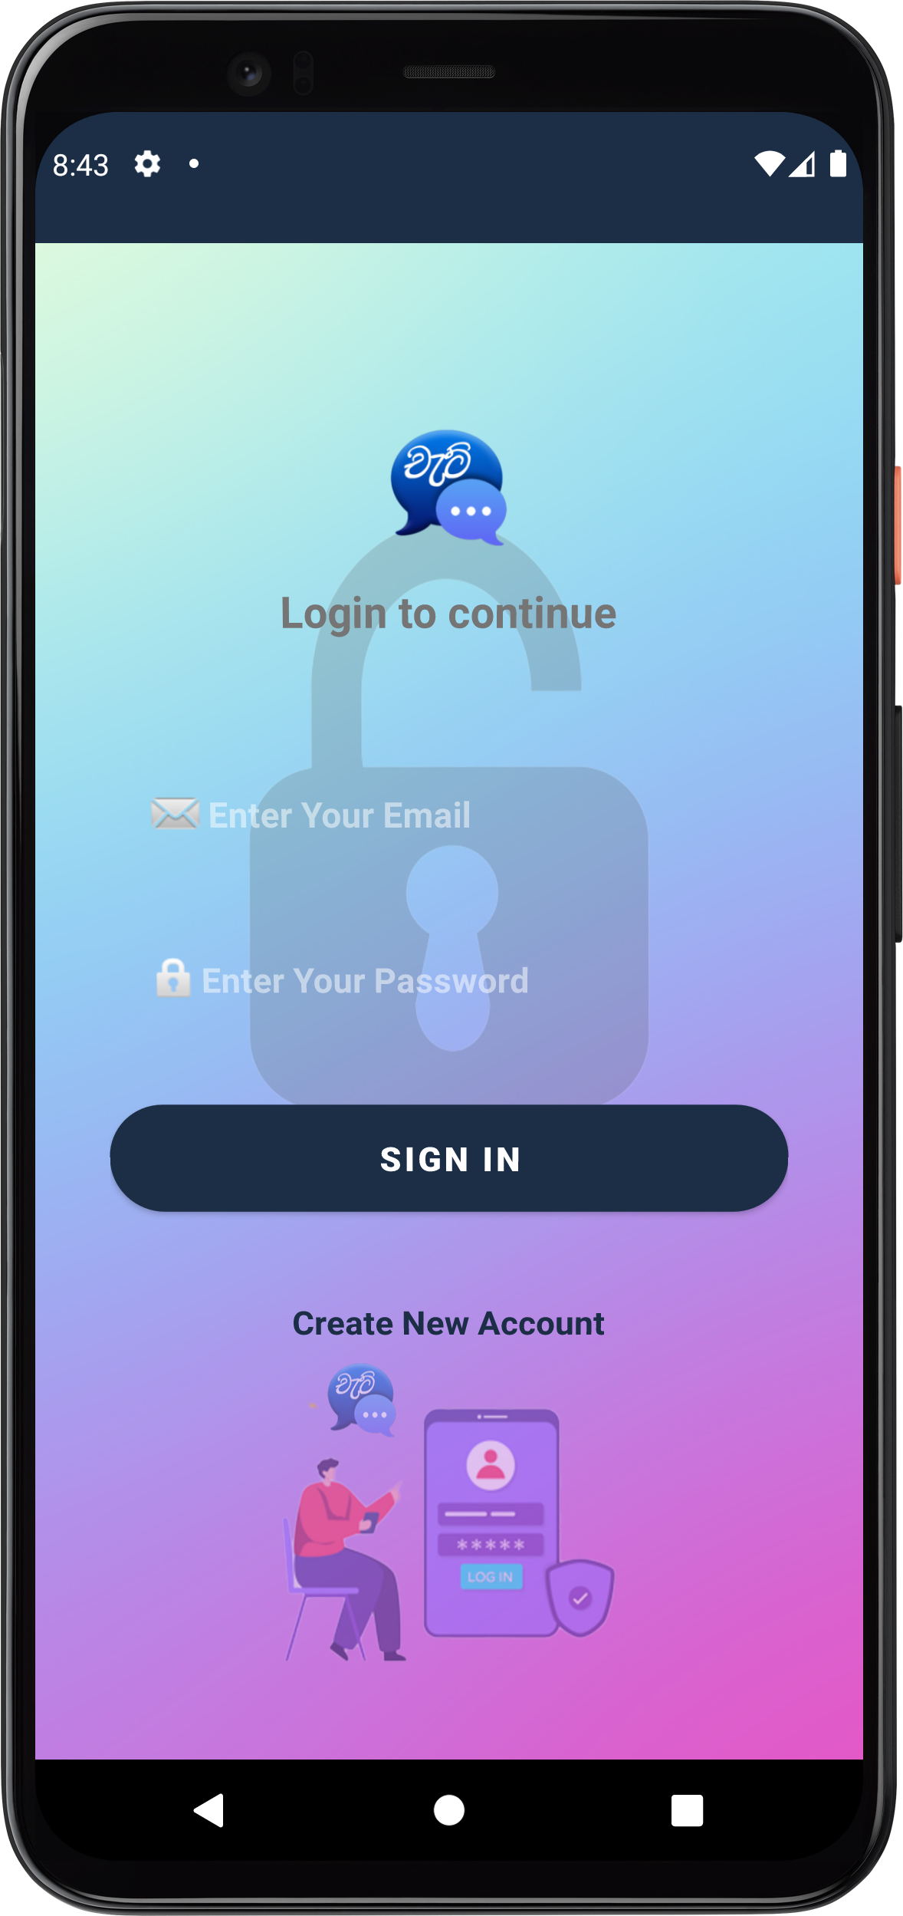
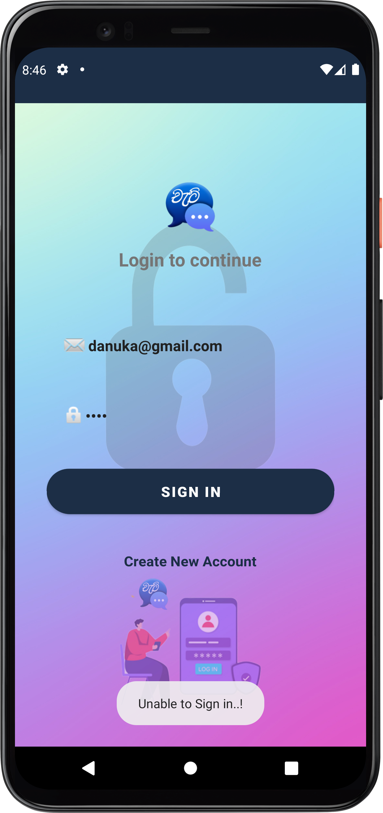
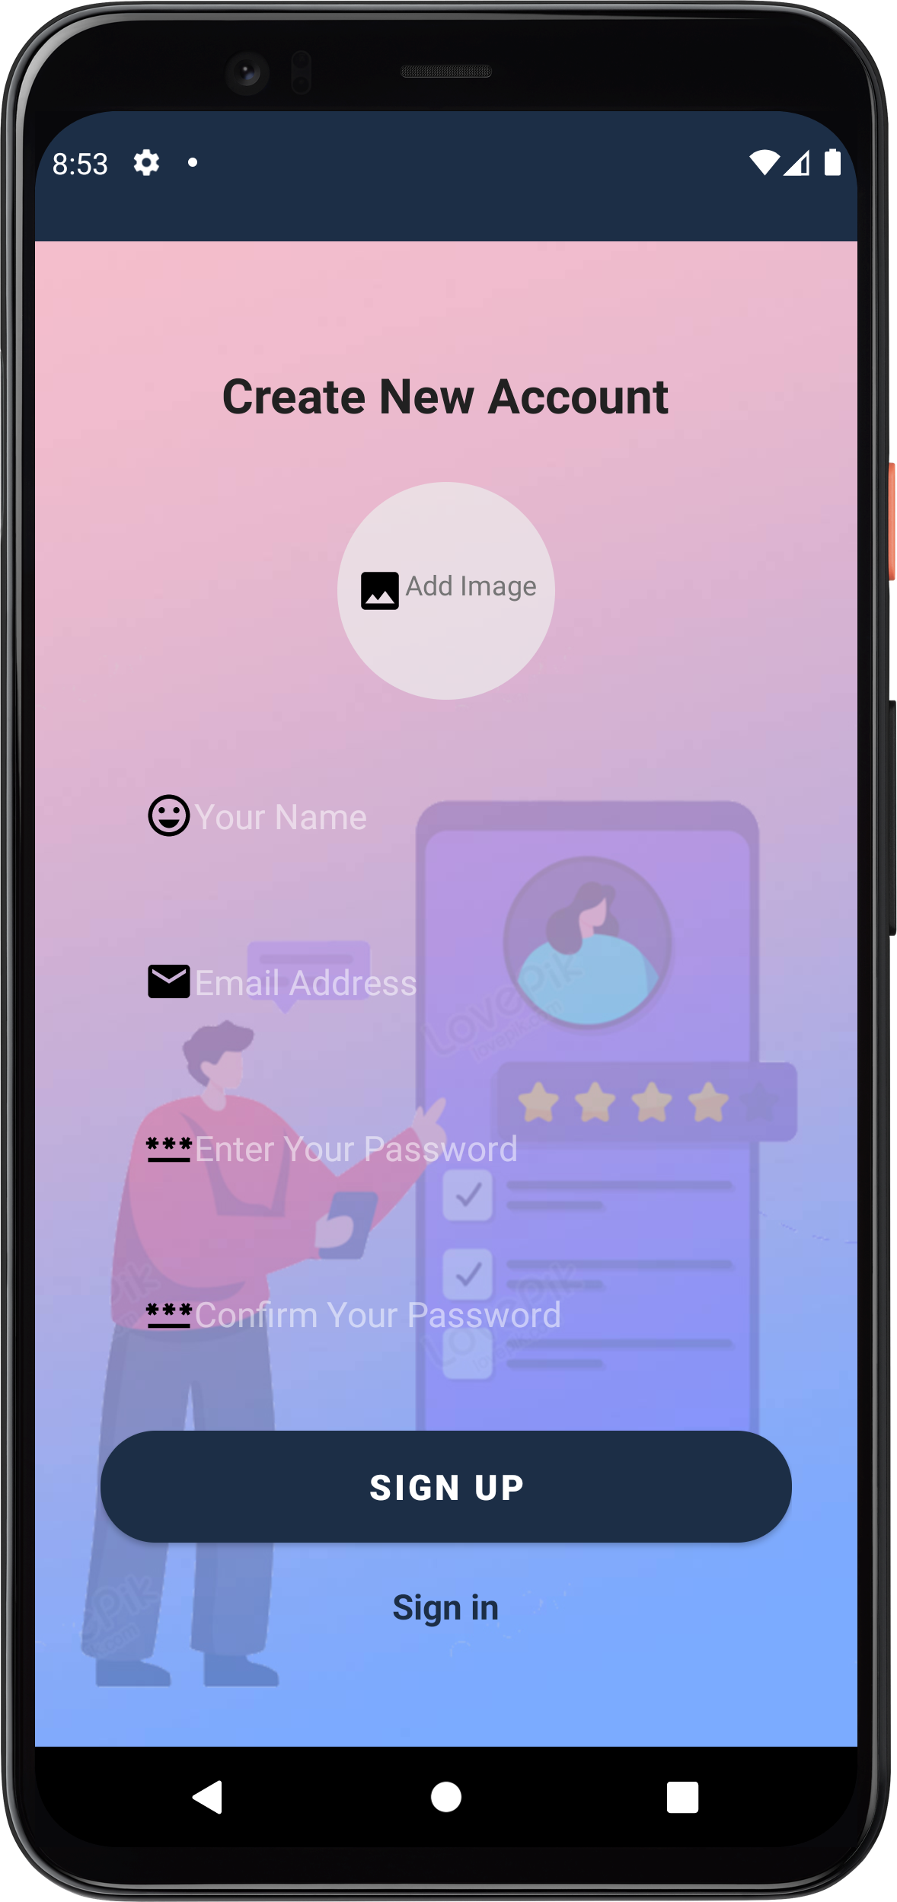
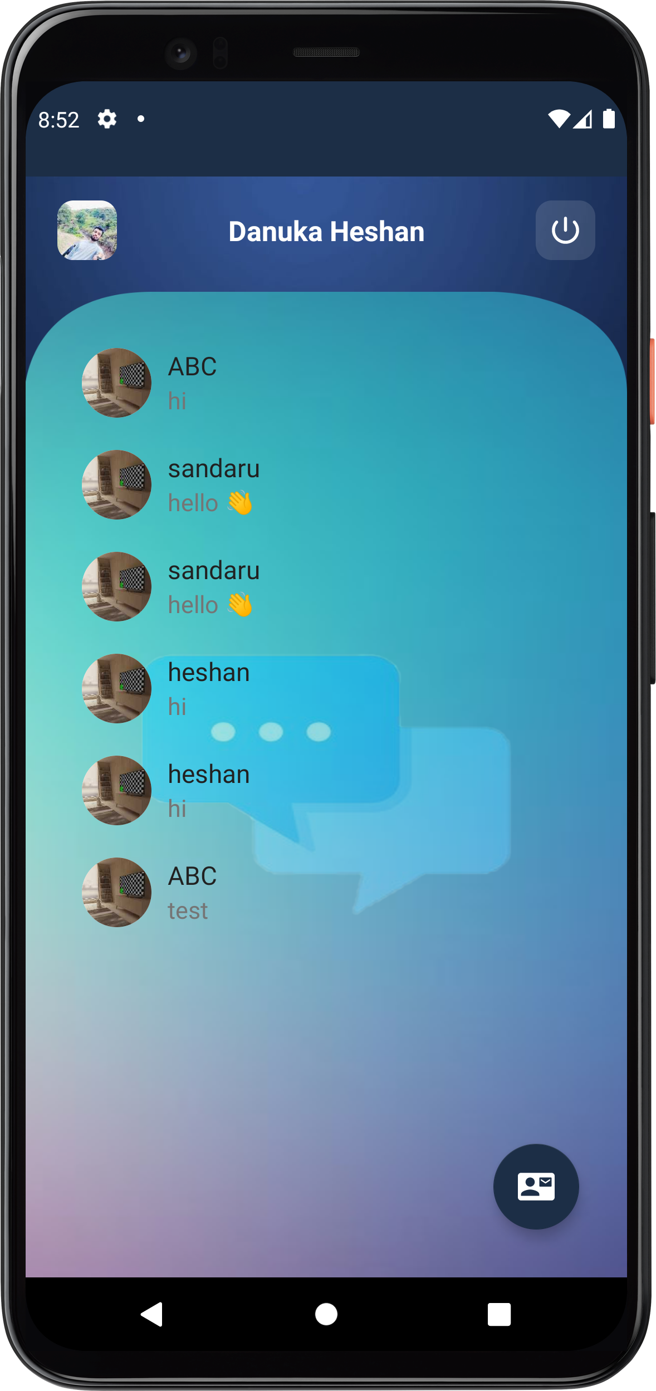
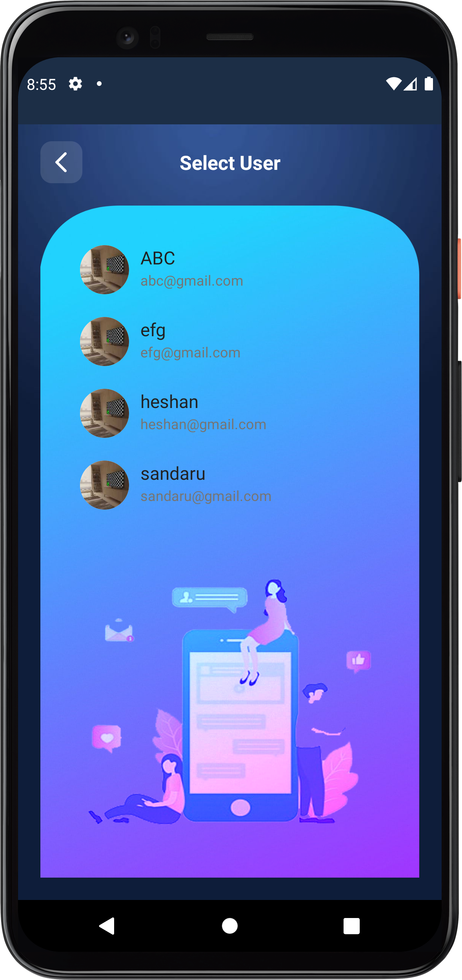
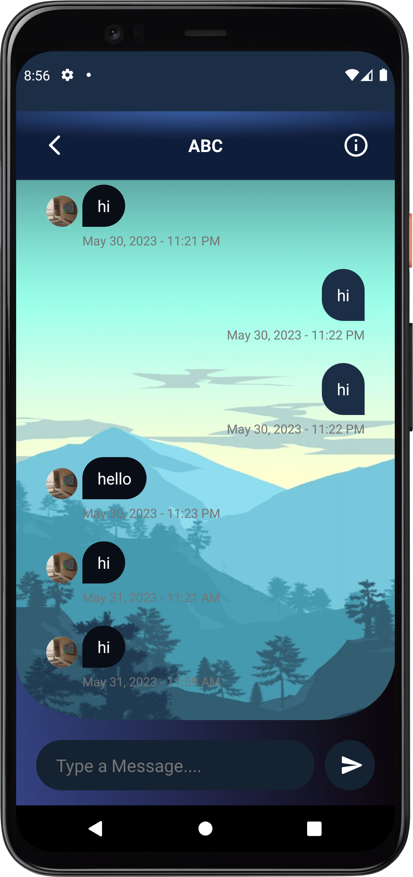
User Interfaces
Log in
Log in error
Sign in
Recent Chat
Contact list
Chat screen

Slide 14
Conclusion
The conclusion is Chat Application is very nice and unique apps in mobile application. This is because it have many advantage if we install and use the application. One of the advantage is we will get our own account for the application. This is easy way to add new friends because we just create an account and automatically they become our new friend. but they you must have internet access. If you don't have internet access, you cant use all the features. So, Chat app is comfortable application and user friendly.
This app also have Realtime database properties. It is because this application can share the information at moments side, integrity because we can save our friends message and friends moments.
We will update have many element of multimedia audio, animation, video and images. Its present animation sticker because it's the way to interact user to chat with their friend. Also provide video call as video as of element multimedia for further development.

Slide 15
References
https://www.youtube.com
https://developer.android.com
https://console.firebase.google.com
https://fcm.googleapis.com/fcm/
Retrofit
https://openai.com/blog/chatgpt
https://stackoverflow.com/

Slide 16
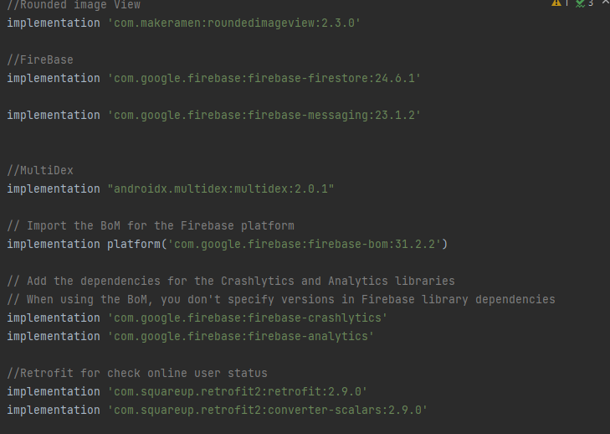
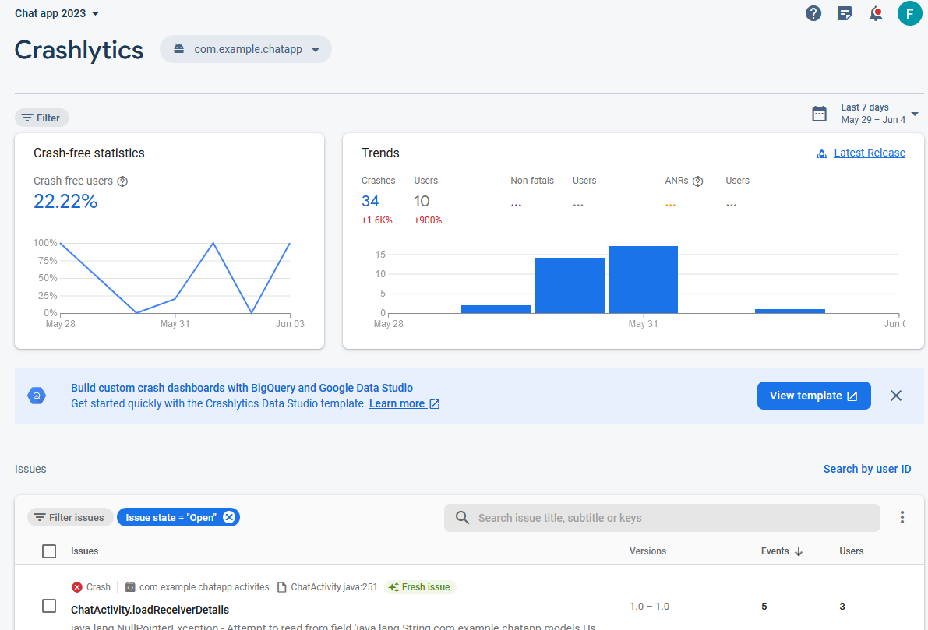
Appendix

Slide 17
Thank you
W.M.D.H.Gunatathna
Email: s92083720@ousl.lk
Reg: 421643720

